Slide 1

Don't You Guys Have Phones?
Crunchy bits

Slide 2
Slish Slash: Enemies Trash
Notes:
Timing-based singleplayer combat game which relies on touch input and is set in a Japanese-influenced dark fantasy world.

Slide 3
Technical Details
Arcade Action Game
Mobile (Android)

Slide 4
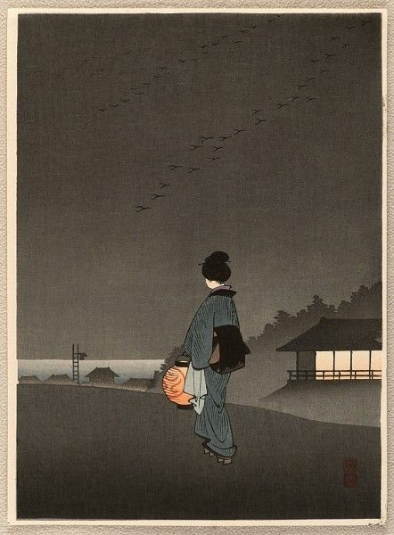
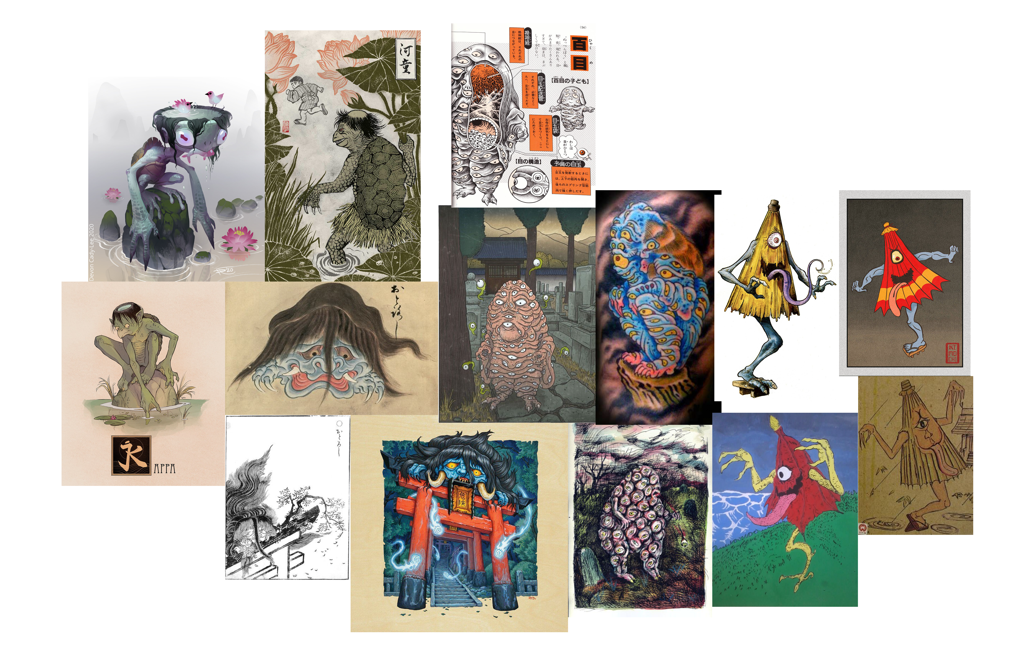
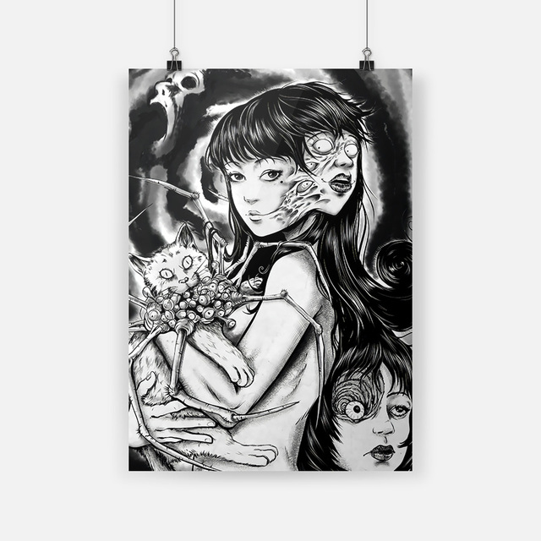
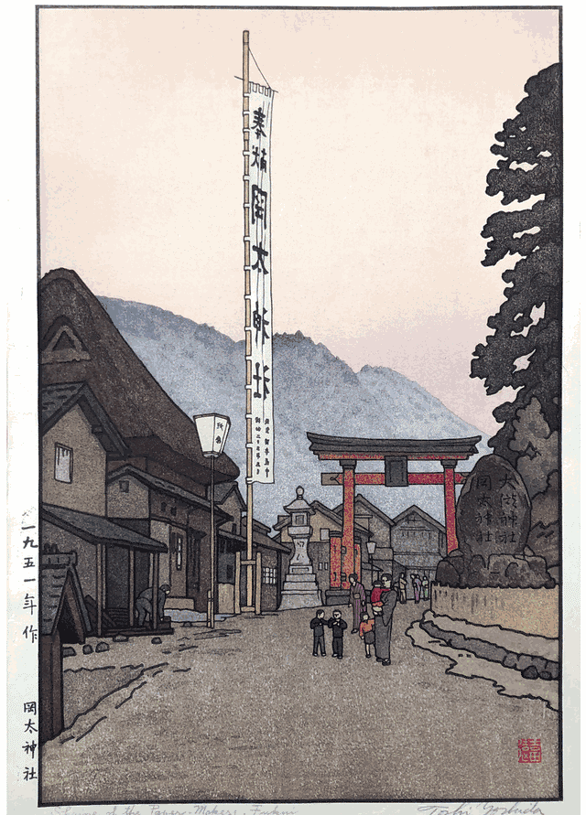
Style & Setting
Notes:
Reference Artists: Junji Ito, Hiroshige IV, Toshi Yoshinda Setting: Japanese mythology -> Youkai

Slide 5
Player Experience Goals
Flow
Mastery
Audiovisual Appeal
Responsive
Timing
Completion

Slide 6
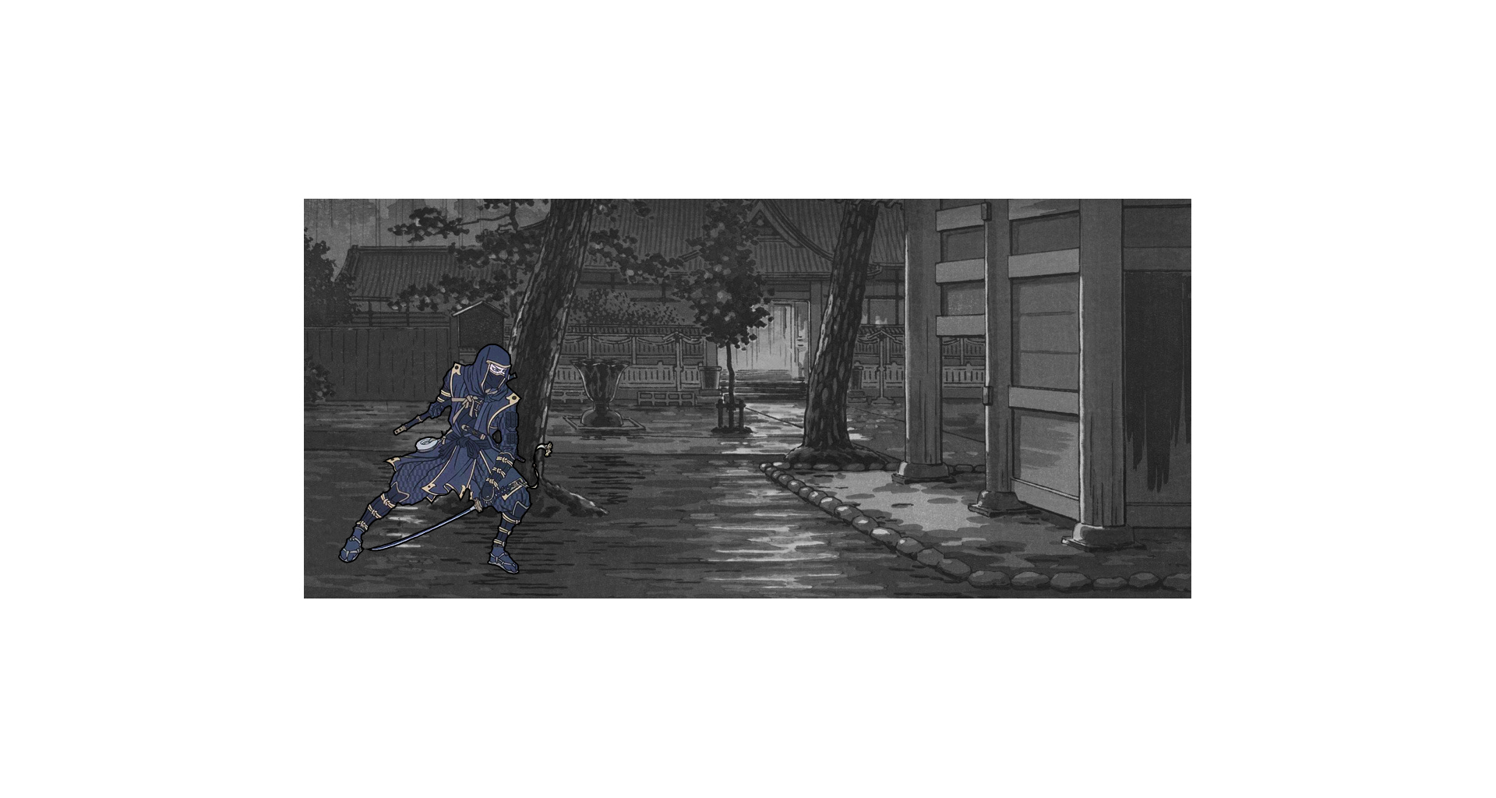
You enter a new location.

Slide 7
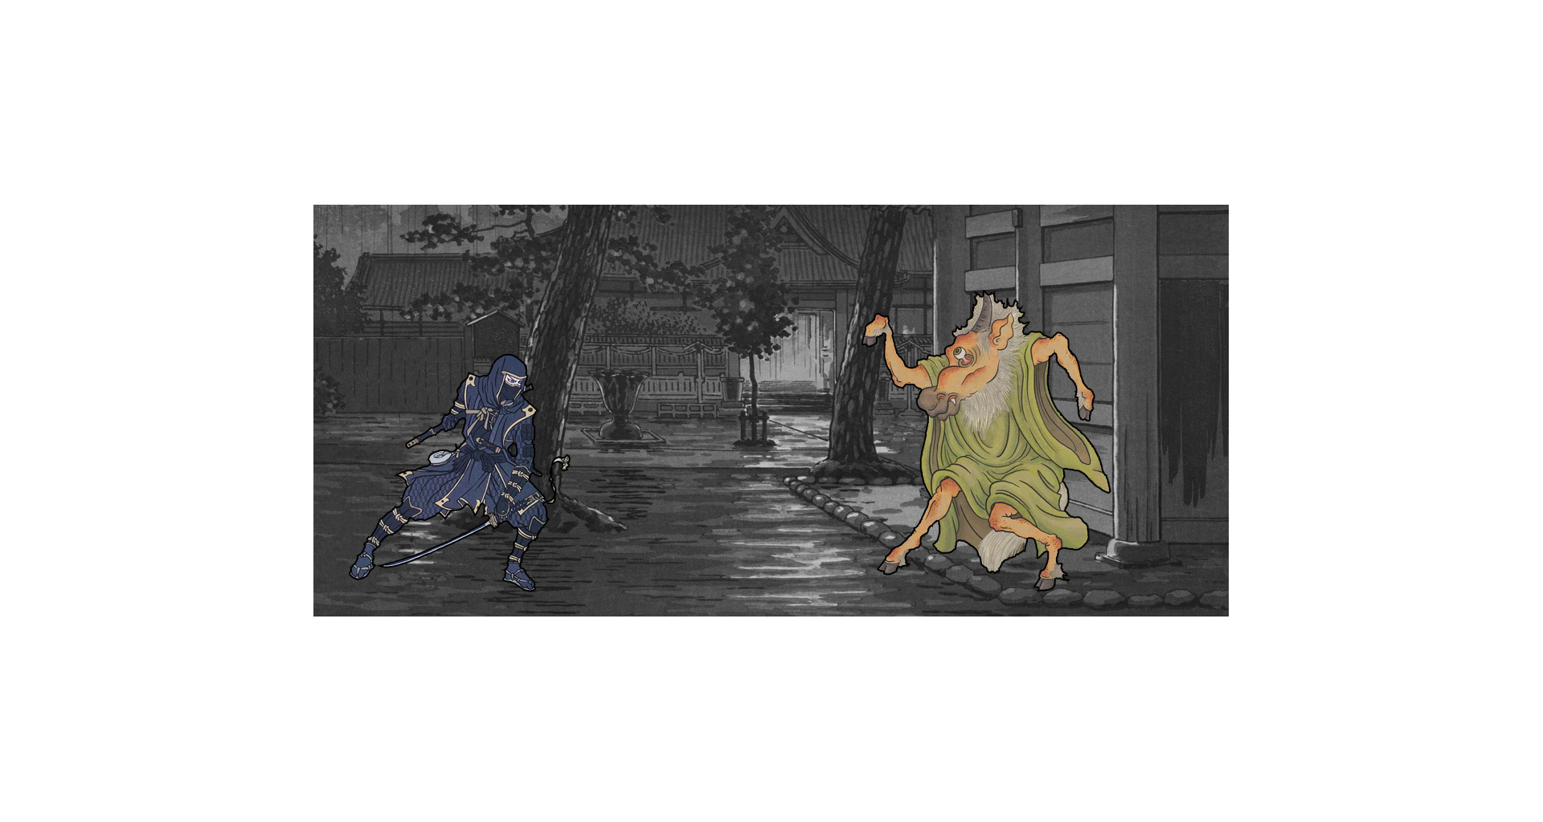
A monster appears: It either attacks or defends.

Slide 8
If it defends: You get to attack first.

Slide 9
If it attacks: You have to parry before it’s your turn.

Slide 10
Monsters have up to three different attacks.

Slide 11
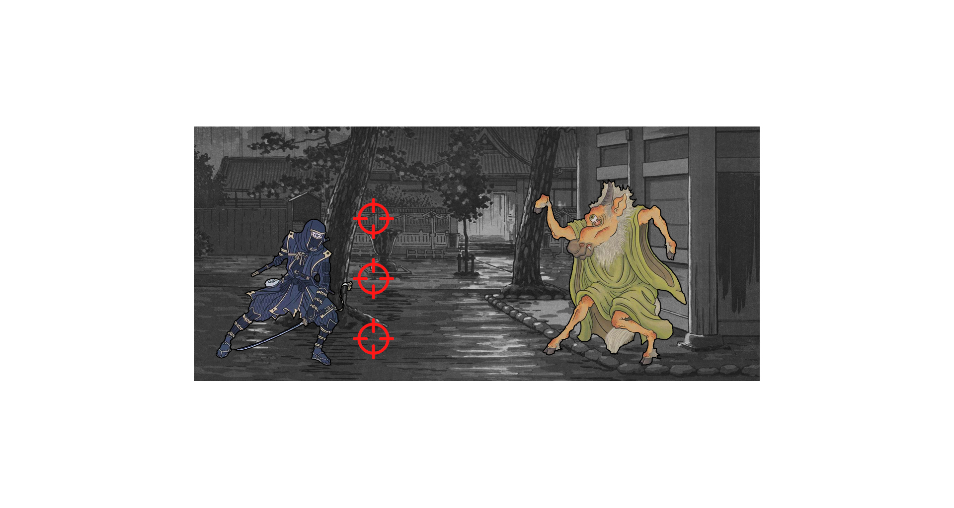
An attack aims either high, low or mid.

Slide 12
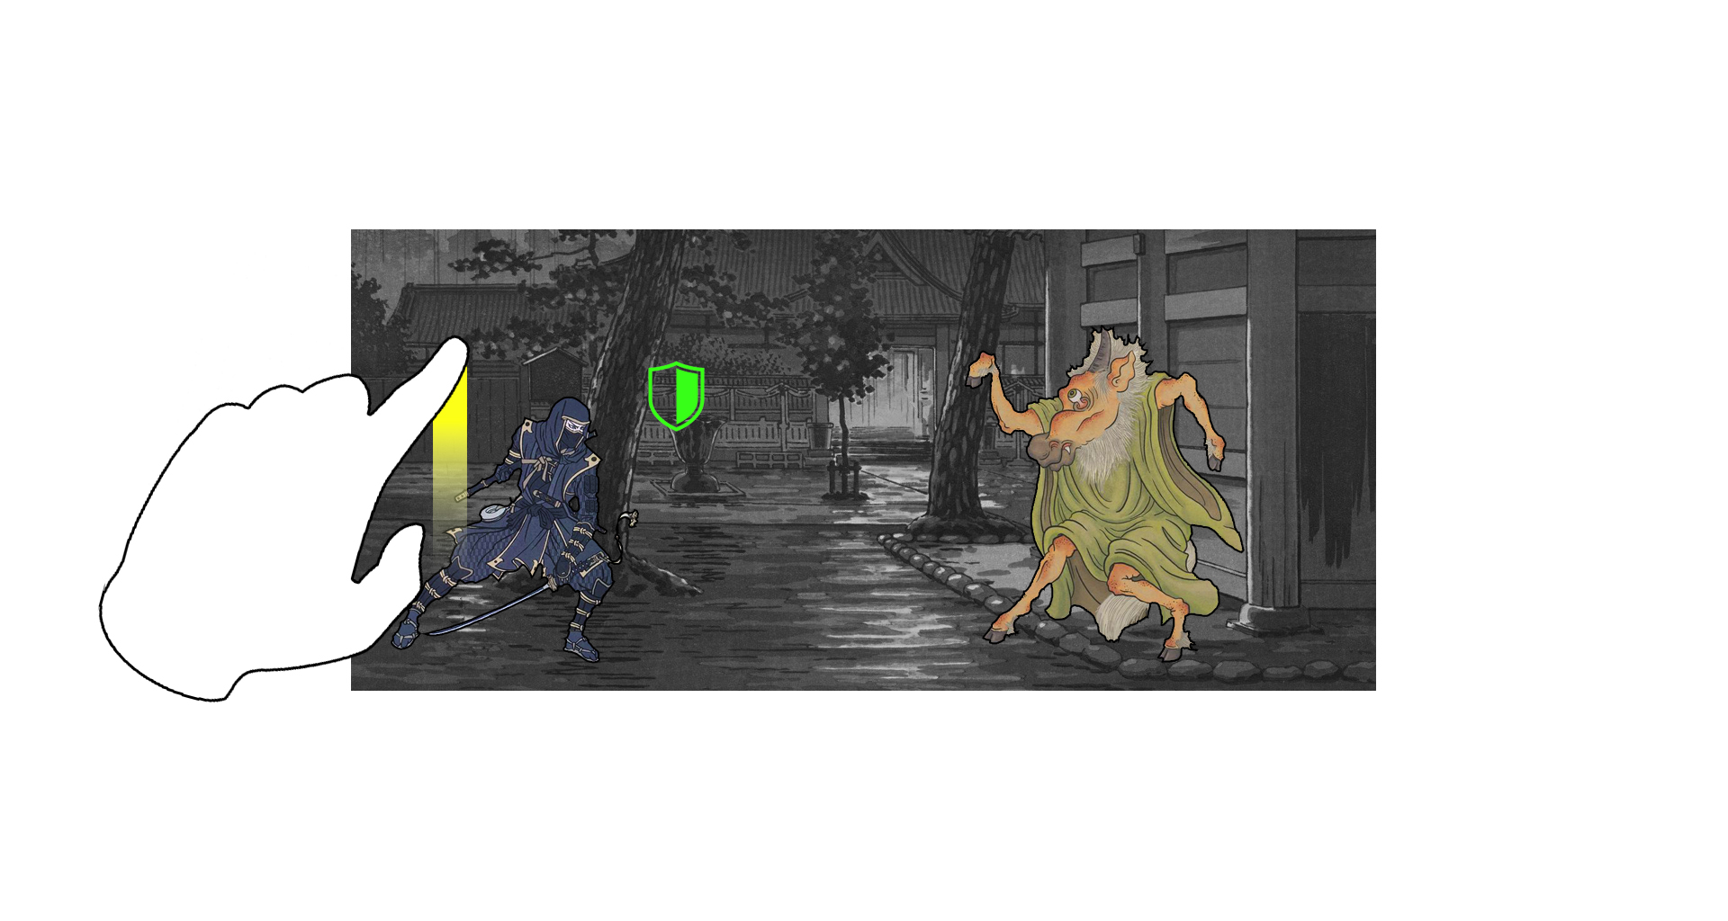
Swipe up to parry high.

Slide 13
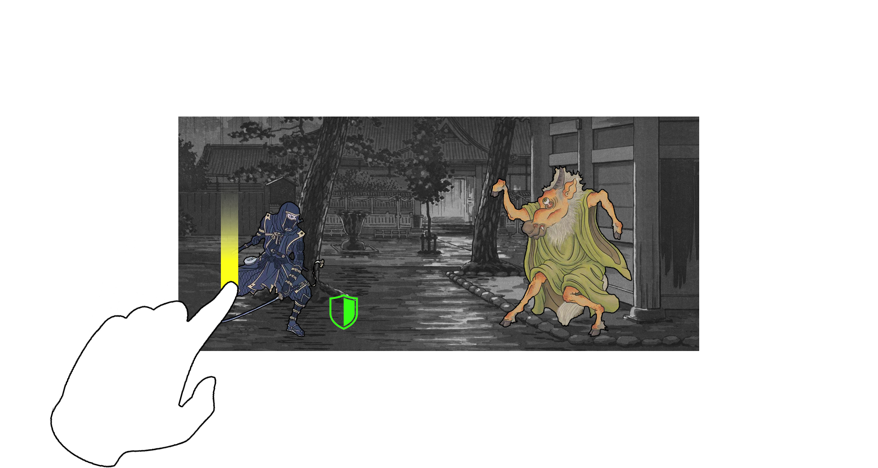
Swipe down to parry low.

Slide 14
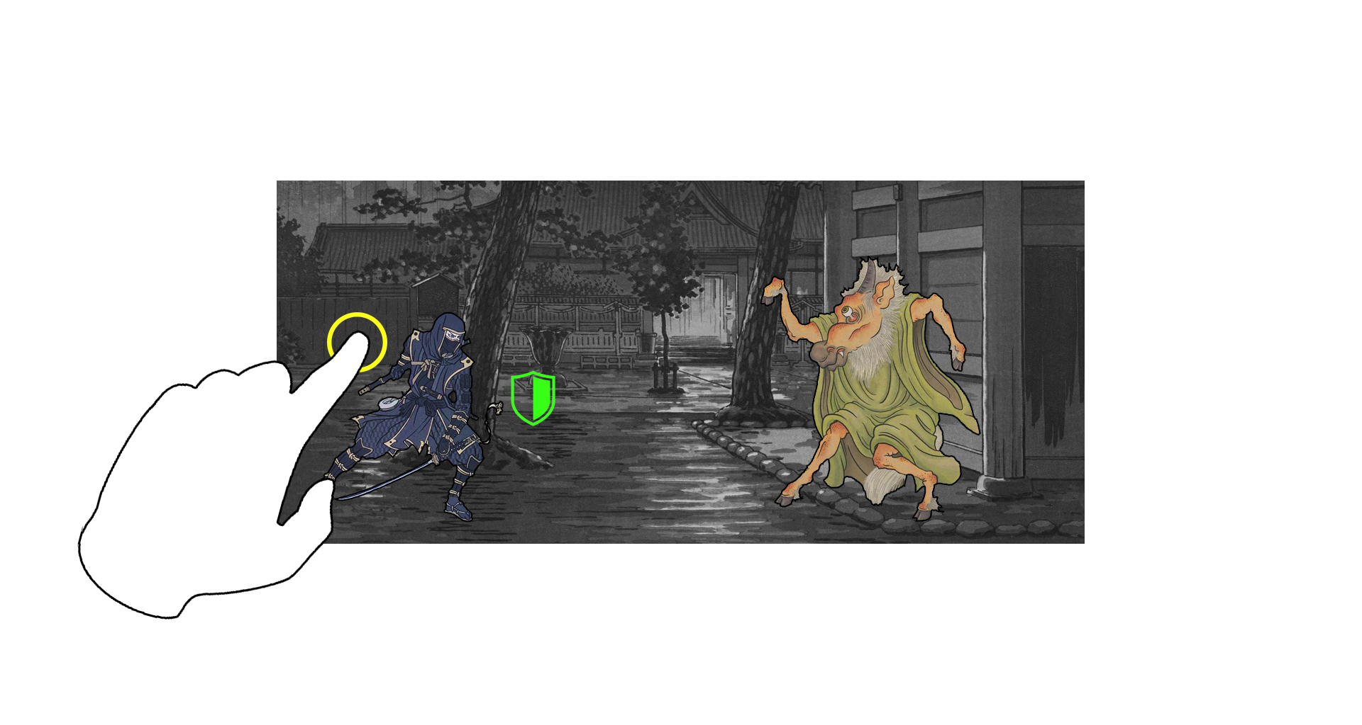
And simply tap to parry center.

Slide 15
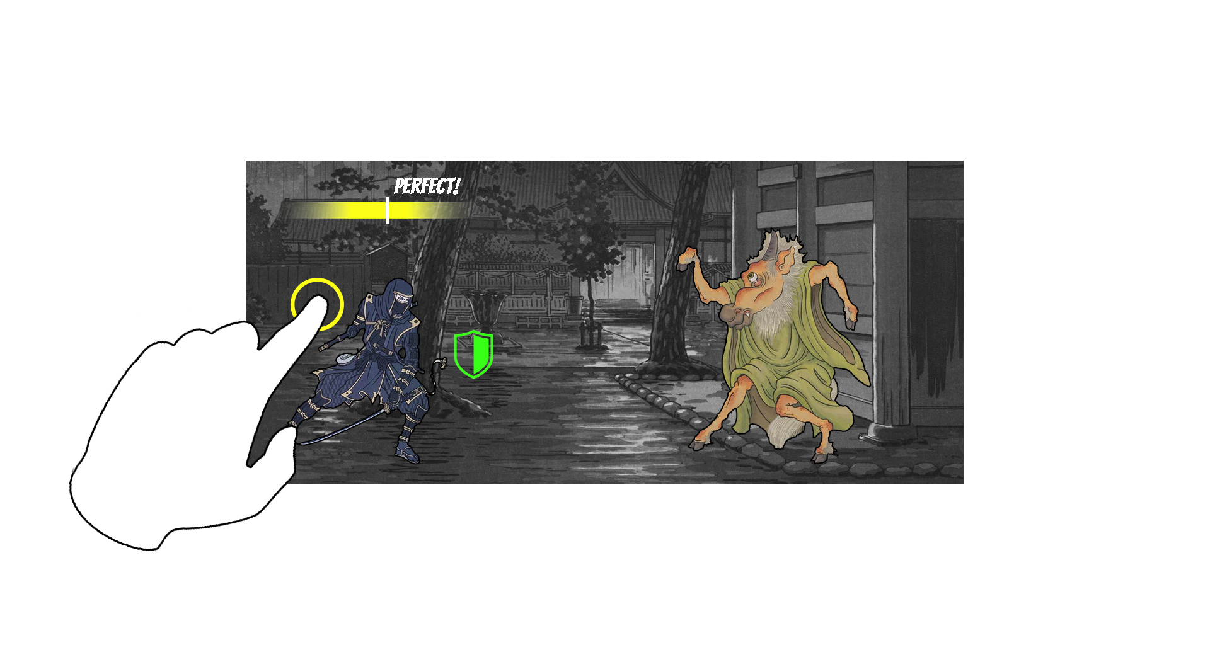
Parries must happen within a certain time frame

Slide 16
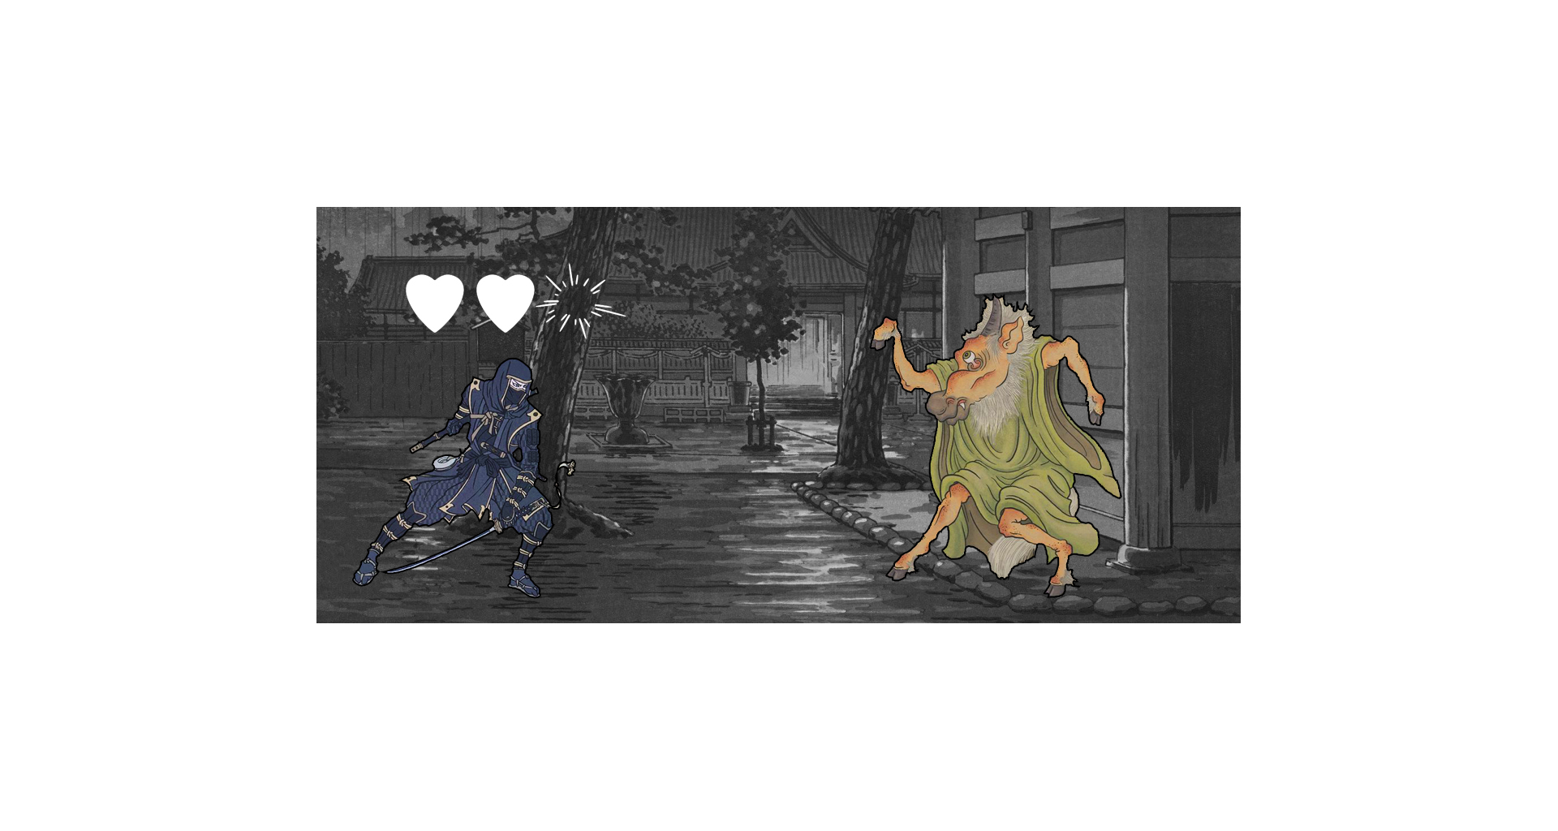
If you fail, you loose health.

Slide 17
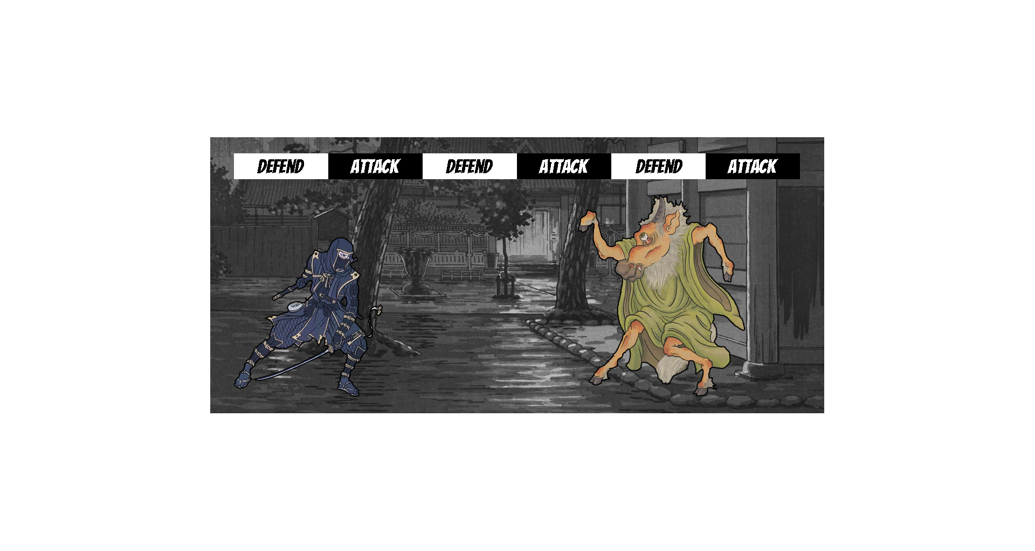
The monster switches from attack to defend

Slide 18
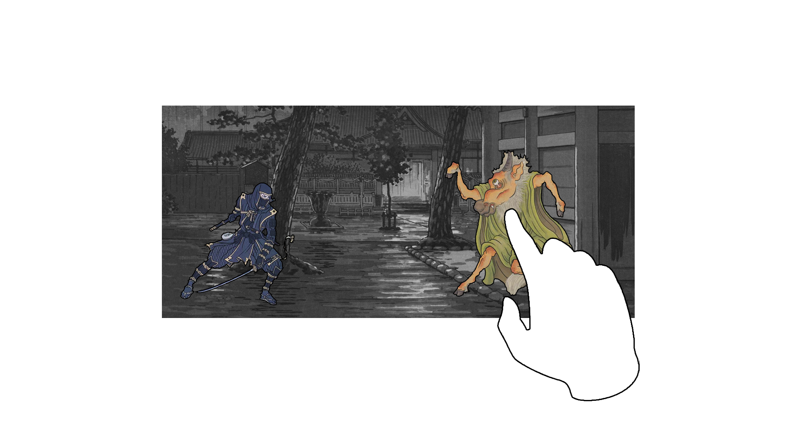
Now you attack: Do a combo of three swipes.

Slide 19
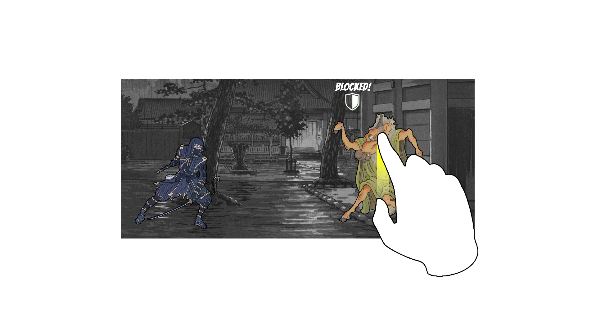
The monster will either block the attack..

Slide 20
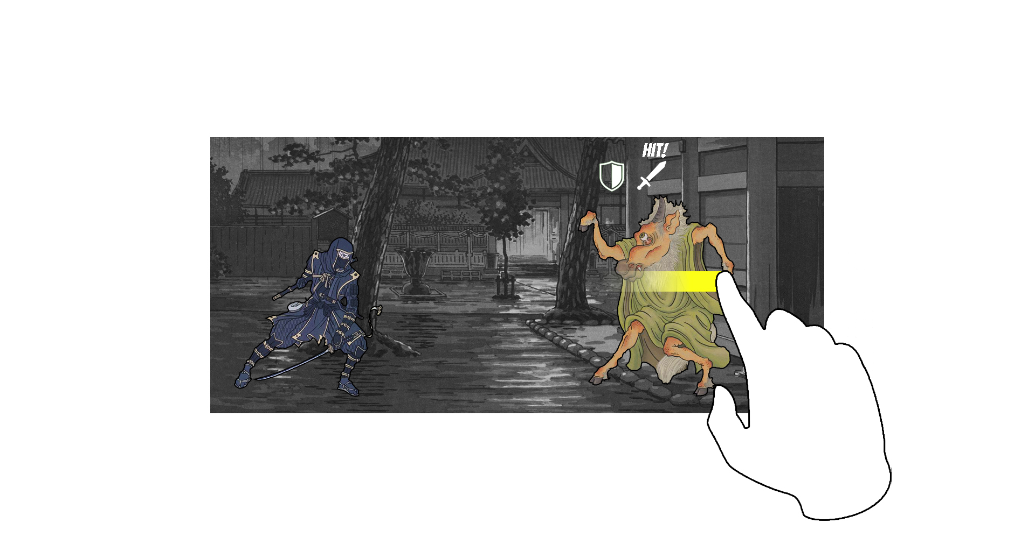
…or take a hit, depending on how you swipe…

Slide 21
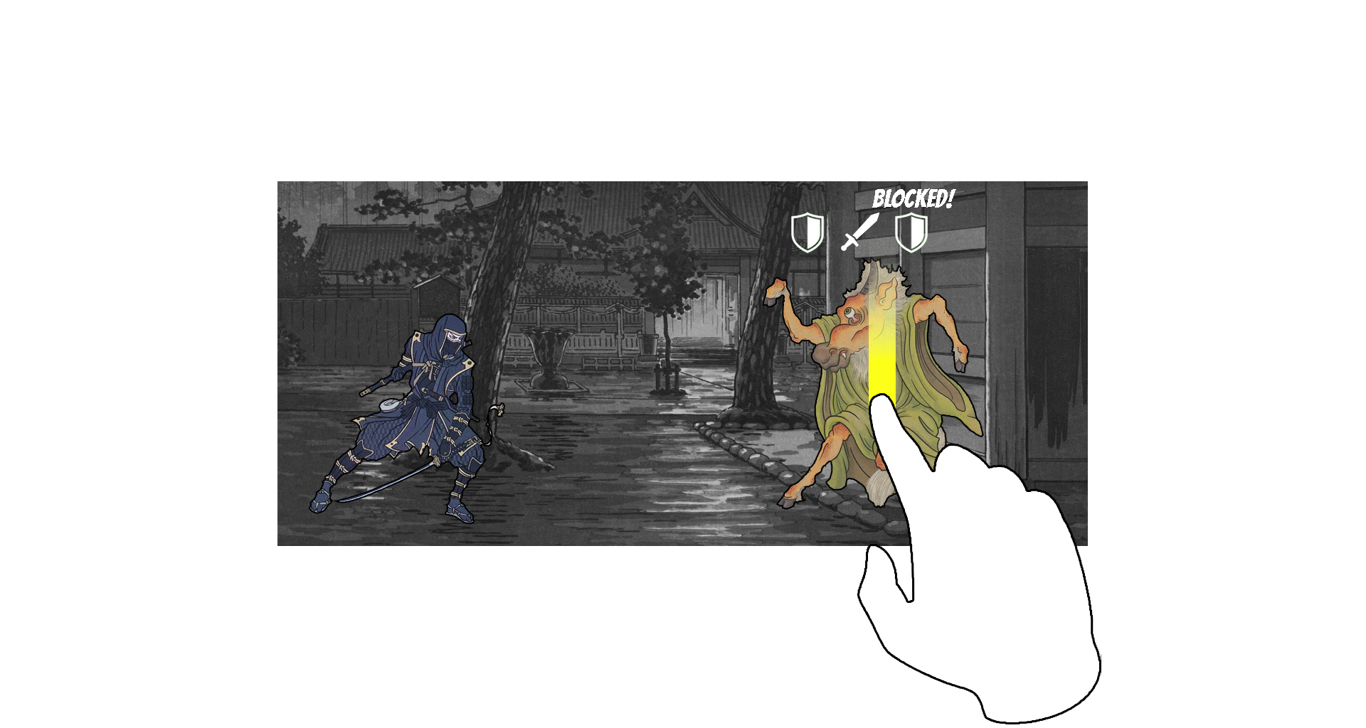
..and when. Find the right combination.

Slide 22
Every monster has its own kill combo. Learn it.

Slide 23
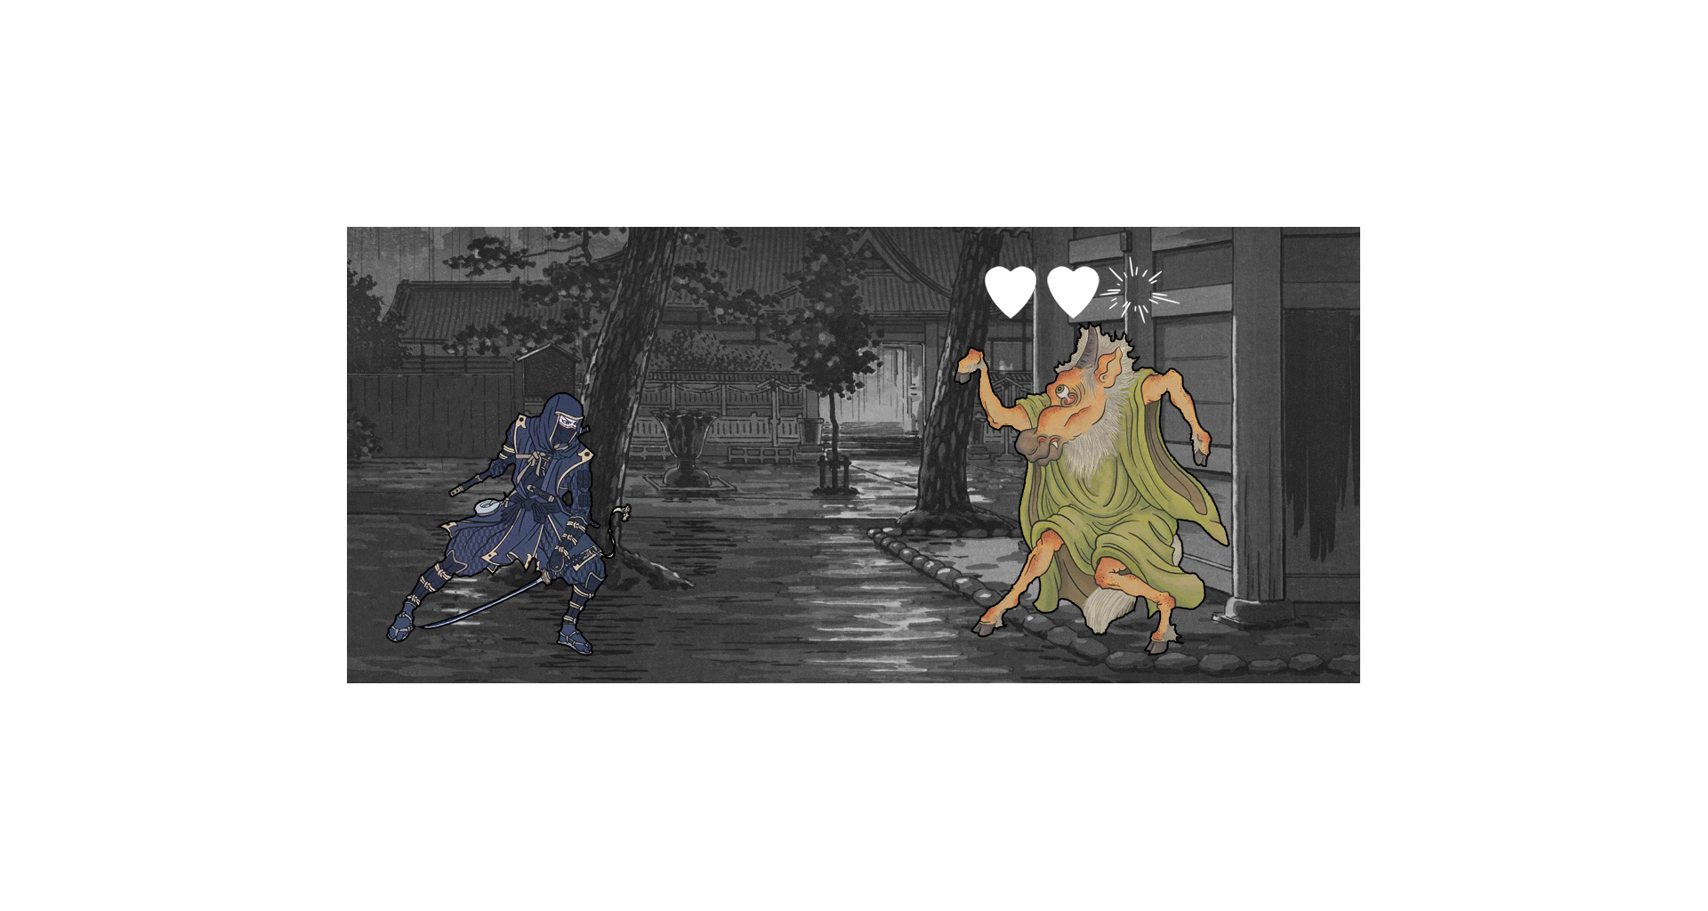
Now, it’s the monster’s turn to loose health.

Slide 24
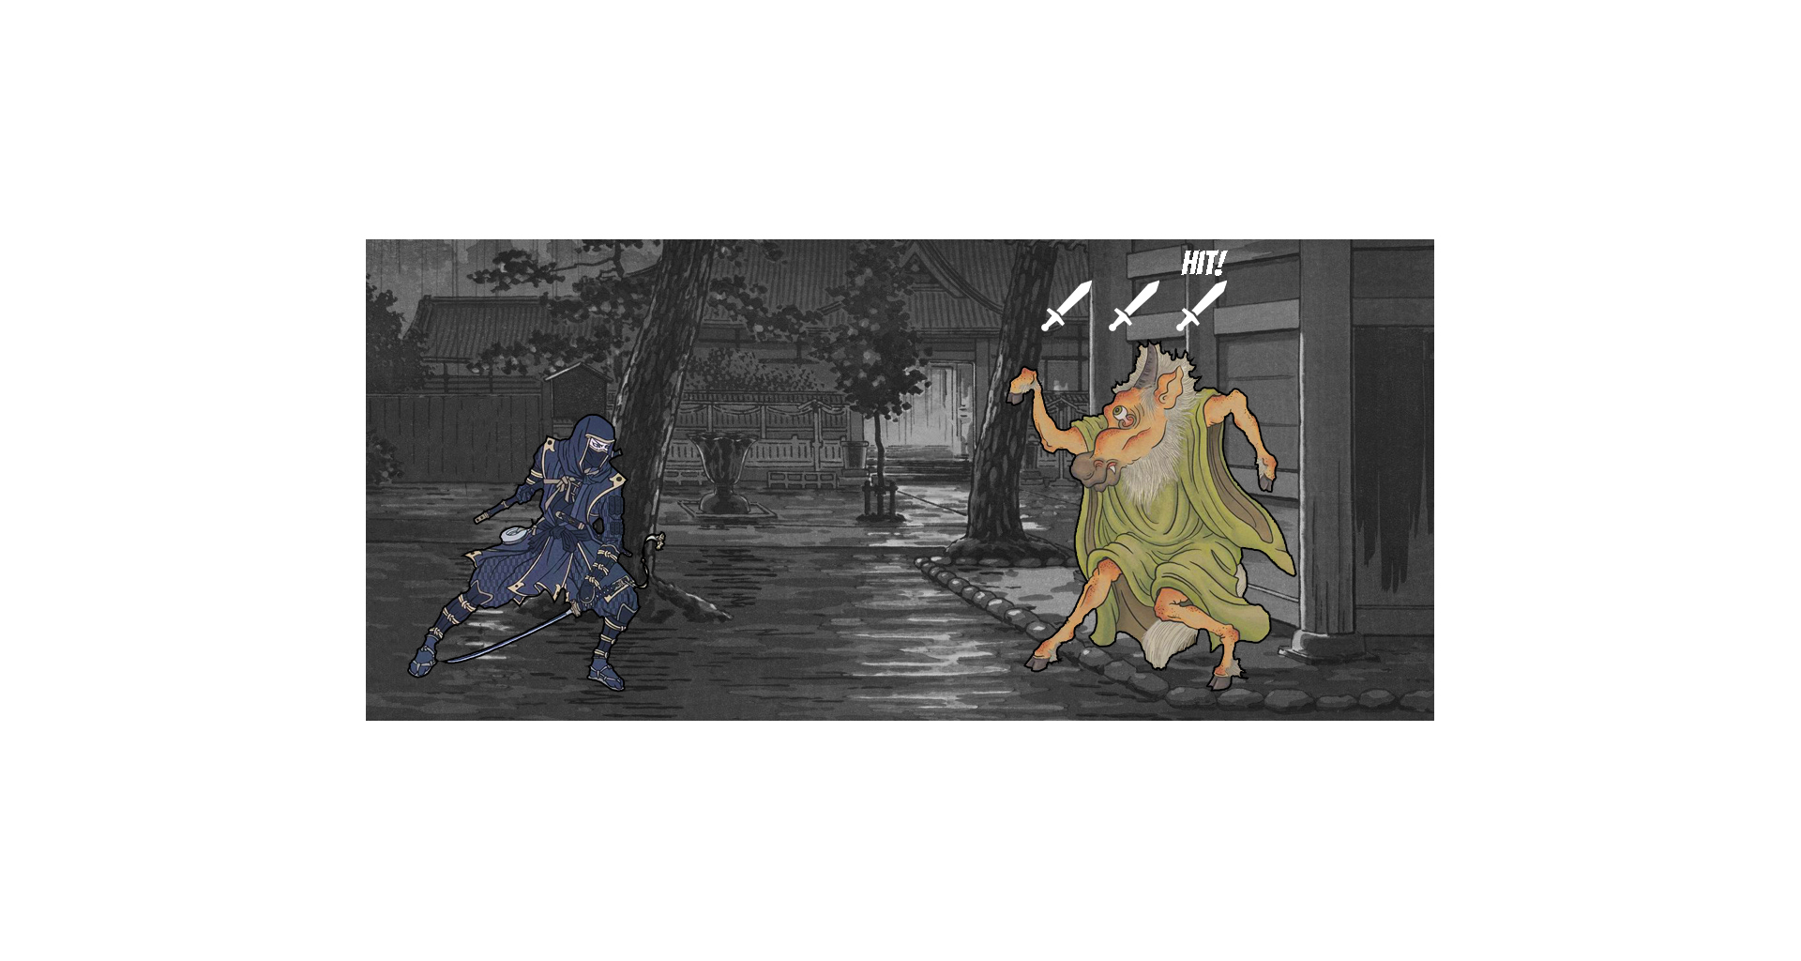
Get the right combo in a single turn to score an
Instakill!

Slide 25
Kill monsters as fast as possible to score points.

Slide 26
Scope
Must Have | Should Have | Nice to Have
Swiping Combat Mechanic | Particle Effects | Bosses
Enemies x3 | Adaptive UI | Enemies x15
Player Character | Overworld | Level x10
Animated | Score | Items
Level x1 | Stylized Shaders (Environment) | Achievements
SFX | Traditional Instrumentation | Unlockables (Skins)
 | Unique Monster Sounds

Slide 27
Project Goals
1: Concentrate on one simple mechanic,
but make it pop!
2: Polish it until it shines.

Slide 28
Crunchy Bits
Role | Name
Producer | Michael Wick
Programming | Ole Ortmann
UI | Waiyaki Otieno
Documentation, All-Rounder | Katharina Bornemann
Sound | Zhaoliang Zhu
Art, Programming | Mohamad Sharkawi
Art | Victor Hübner
Art | Hendrik Wagner
Art | Angeli Fernando
Art | Moritz Schmidt

